Slide 1
DOE’s Centralized Storage Design Alternatives and Security Regulations
Jeff Williams
Project Director, Nuclear Fuels Storage and Transportation
Office of Nuclear Energy
World Institute for Nuclear Security
June 10-12, 2014
Notes:
TH31 – Future Vision of Spent Fuel Storage – Back-End Friendly Fuel Designs and Holistic Safety Security Interface

Slide 2
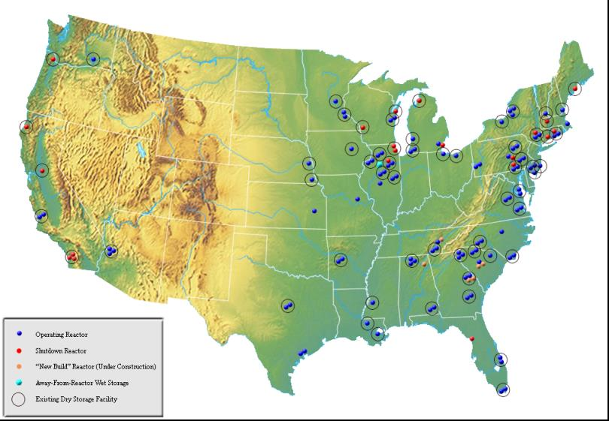
US History of Commercial Power Reactors
130 Nuclear Power Plants Built for Commercial Power Generation
9 Early Prototypes
  No fuel on site
1 Never Operated
1 Disabled
  Fuel moved to DOE
1 Demonstration High Temperature Gas Reactor
18 Ceased Operations
  Fuel on site
  3 reactors on sites with on going nuclear operations
  15 reactors on 12 sites with no other nuclear operations
100 Operating Reactors
6 New Units Under Active Construction

Slide 3
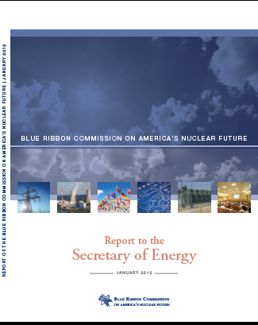
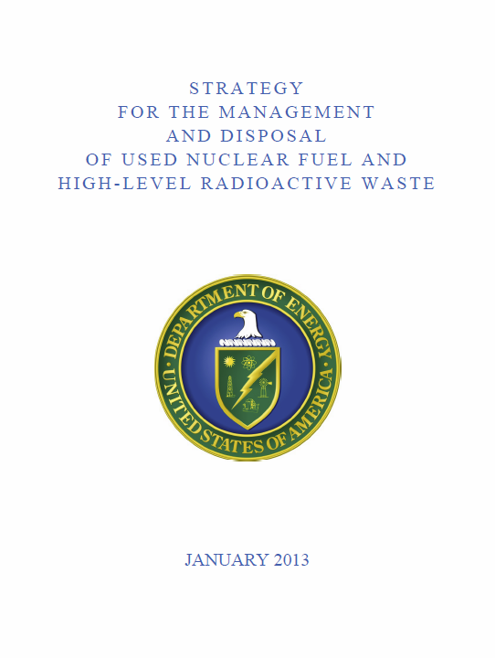
Blue Ribbon Commission on America’s Nuclear Future Reviewed the Back End of the Nuclear Cycle
Emphasized Interim Storage as Part of an Integrated Waste Management System
Consolidated Storage would…
  Allow for the removal of ‘stranded’ spent fuel from shutdown reactor sites
  Enable the federal government to begin meeting waste acceptance obligations
  Provide flexibility to respond to lessons learned from Fukushima and other events
  Support the repository program
  Provide options for increased flexibility and efficiency in storage and
  future waste handling functions
The Administration agrees that interim storage should be
included as a critical element in the waste management system
The Administration supports a pilot interim storage facility initially focused on serving shut-down reactor sites.

Slide 4
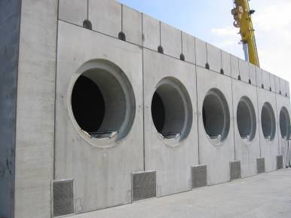
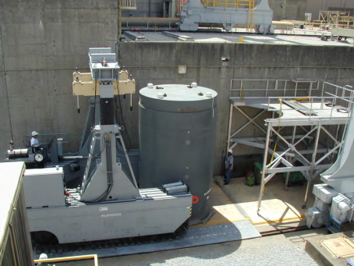
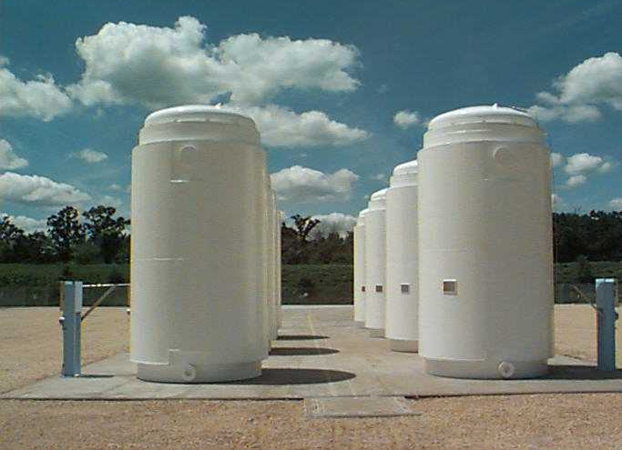
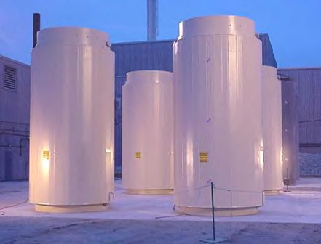
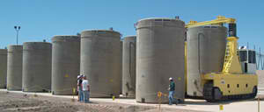
Dry Storage Inventory
1,655 Welded Metal Canisters In Vented Concrete Overpacks
65,102 Assemblies,
87.5% of Dry
Transnuclear (34%)
Holtec (41%)
NAC (10%)
12 Welded Metal Canisters
in Transport Overpacks
866 Assemblies, 1.2% of Dry
Majority is in Large Welded Canisters
Current dry storage inventory is diverse
Trend toward higher capacities
183 Bare Fuel Casks
8,406 Assemblies, 11.3% of Dry
Transnuclear TN-32
Holtec Hi-Star 100
World Institute for Nuclear Security, June 10-12, 2014

Slide 5
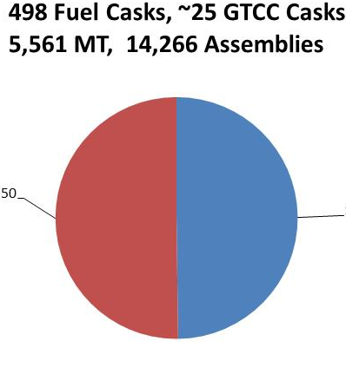
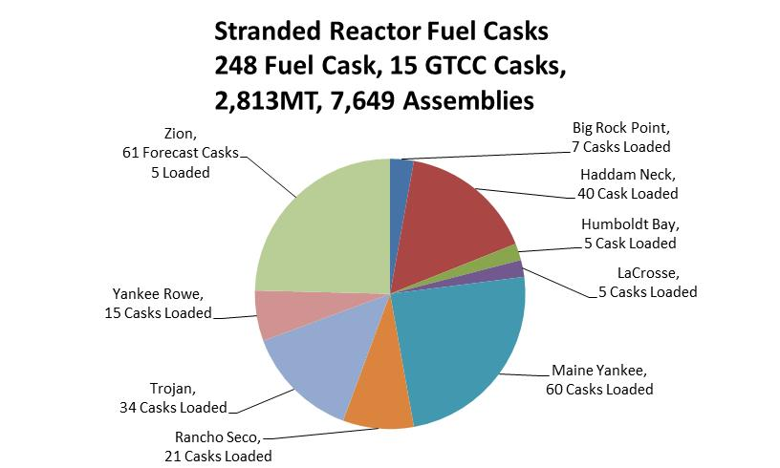
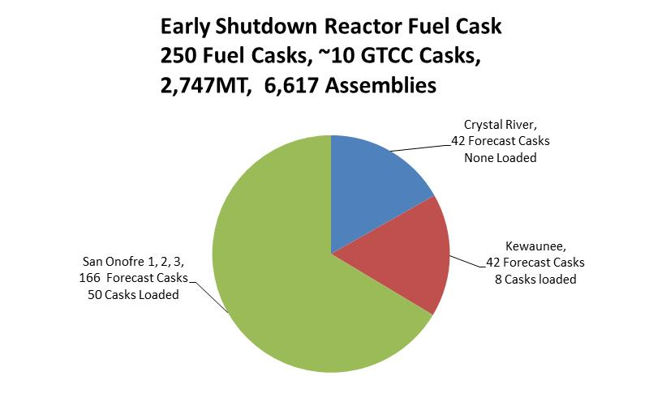
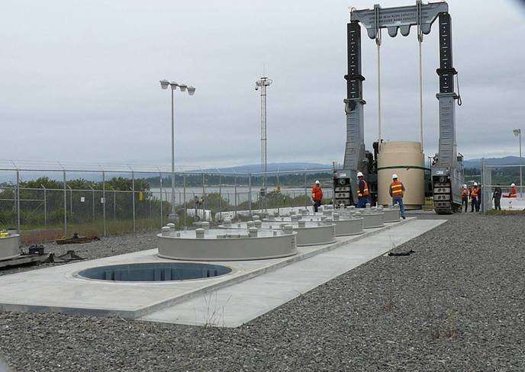
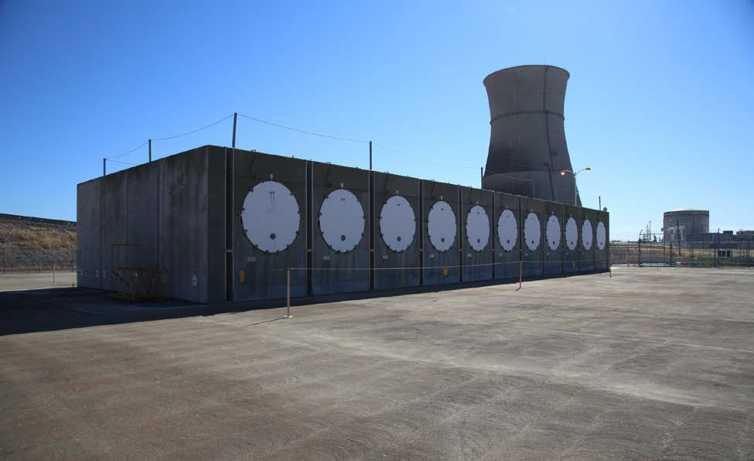
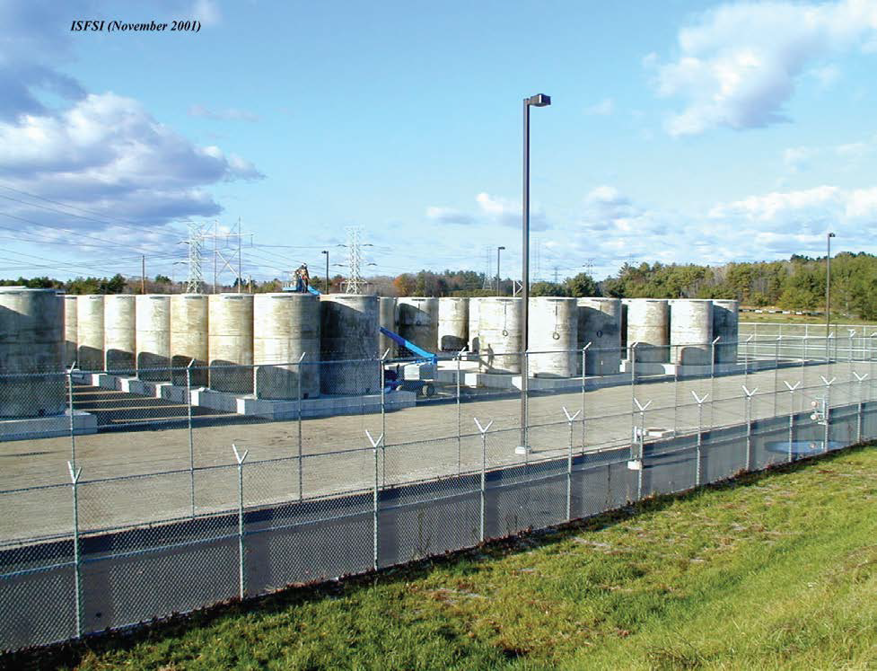
Shutdown Reactor Sites are Increasing in Number and Use Several Different Storage Designs
  Humboldt Bay, Holtec
  below grade
  Rancho Seco, TN
  horizontal
  Maine Yankee, NAC
  vertical
Excludes shutdown reactors at operating sites
Notes:
Could drop this slide

Slide 6
Pilot Storage Facility – Concept
  Transport fuel dual purpose canisters (DPC) in associated transportation overpacks
  Transfer the DPC to a new storage overpack associated with each DPC
  9 stranded sites use 13 canister designs, 8 storage, and 7 transport overpack designs
    Transition from 10CFR72 to 10CFR71 to 10CFR72
    Aging Management Plans expected
5,000 to 10,000 MT capacity with a receipt rate of 1,500 MT/y
  Accept dry storage containers from initially “stranded” sites
Fully developed facilities will include:
  Rail yard and associated maintenance equipment
  Cask-handling building for transfer of the DPC from transportation to storage overpacks
  Storage pads with multiple vertical and horizontal storage overpack designs
  Security facilities
  Infrastructure and balance of plant facilities

Slide 7
Pilot Alternative Designs
(Flexible, Adaptable, and Expandable)
Dry Storage Alternatives
  Vented concrete at grade in horizontal and vertical
  vendor specific systems currently in use
  Vaults for dry canisters
  Universal storage overpacks
  Universal underground systems
Required Support Systems/Facilities
  Cask-handling facility
    large shielded cell vs. transfer cask may offer time in motion and ALARA advantages
  Storage overpack fabrication
  Rail and cask maintenance
  Security systems, infrastructure, and balance of plant
Potential Co-located Systems (may or may not be deployed with Pilot)
  Laboratory for supporting long-term storage and developing repackaging techniques
  Fuel remediation capability for damaged or failed fuel
  Related manufacturing facilities
  Humboldt Bay Underground Storage

Slide 8
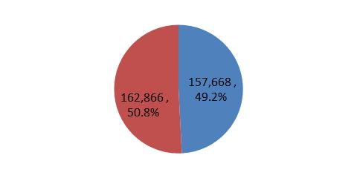
Larger ISF - Inventory and Concept
DOE Strategy document provides guidance
  Larger ISF starts operations in 2025
  “20,000 MT or greater”
  Receipt rate is “greater than” the U.S. discharge rate (approximately 2000 MT/y), working basis is 3,000 MT/y
  Repository starts operation in 2048
  Modular approach for functional capability and capacity increases and provide flexibility
Pool
44,000 MT
Dry
48,200 MT
  2024 Projected Inventory
Working basis for Larger ISF capacity is about 70,000 MT
  Based on 3,000 MT/y receipt rate and Strategy schedule (2048 repository)
Continued DPC storage using the storage method selected for the Pilot
Significant bare fuel receipt and storage capability may be needed for efficient acceptance from reactors
8

Slide 9
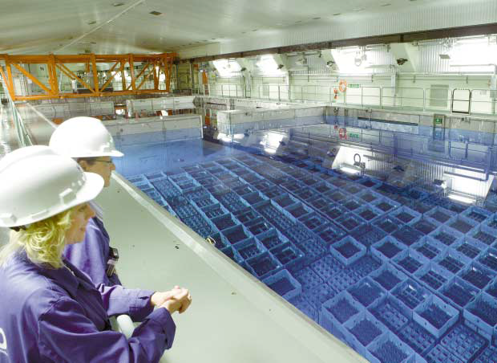
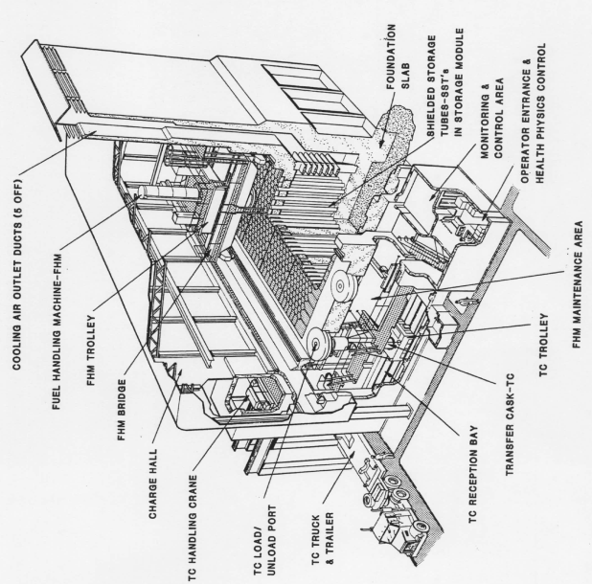
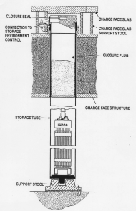
Larger ISF Design Concepts
Bare Fuel Storage Method May be
Key ISF Attribute
Bare fuel receipt and storage systems
  Pools – technically mature, large, expensive, under scrutiny
    Choice for Central Interim Storage in Sweden (CLAB)
  Continue to load dry canisters
    decay heat per package may limit transportation
    and disposal
    DSC may become LLW if repackaging for disposal
    is required
  Vaults
    approach being used in Spain
Dry storage continues using
technologies selected for the Pilot
Support facility capacity increases
  Examine a range of receipt rates
Potential packaging facility to support disposal if required
9

Slide 10
Significant System-Wide Benefits from Standardization
Benefits of Standardization
  Reduced system cost, mainly from avoidance of extra expenditures and operational efficiencies
  Simplified operations throughout the system
  Reduced uncertainties associated with waste acceptance and system performance
  Minimized repackaging
  Opportunities include canisters, overpacks, casks, and ancillary equipment
In the absence of known disposal requirements, legitimate questions persist about what, when, and how to standardize

Slide 11
ISF Security
The ISF is currently envisioned as a 10 CFR 72 ISFSI governed by U.S. Nuclear Regulatory Commission requirements
Security regulations in 10 CFR 72 refer to a specific section of 10 CFR 73 “Physical Protection of Plants and Materials”
There are no particular additional requirements for ISF security based on its comparatively large scale vs. plant ISFSIs
DOE will base its security design and safeguard plans on best practices from existing stand-alone facilities in the U.S. (i.e., not located within the protected area of an operating reactor facility)

Slide 12
Concluding Remarks
DOE is:
  Conducting planning, per the Administration’s Strategy, toward integration of storage as a planned part of the waste management system
  Evaluating options and trade-offs relative to utility preferences and waste management system integration
  Assessing standardization and feasibility of direct disposal of DPCs
  Assessing generic interim storage facility design alternatives
  DOE will base its security design and safeguard plans on best practices from existing stand-alone facilities in the U.S. (i.e., not located within the protected area of an operating reactor facility)
Full implementation of the Administration’s Strategy will require legislation

